Slide 1



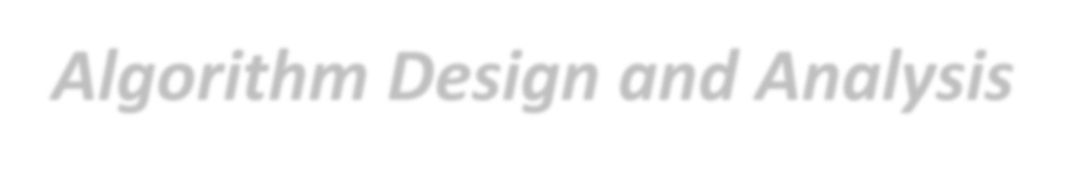
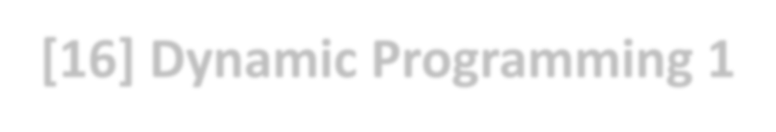
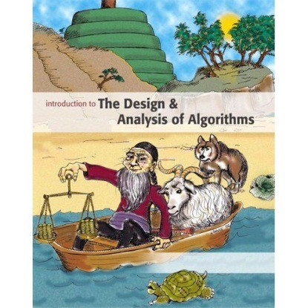
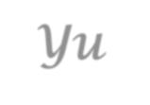
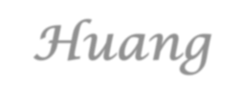
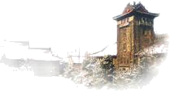
Introduction to
Algorithm Design and Analysis
[16] Dynamic Programming 1
Yu Huang
http://cs.nju.edu.cn/yuhuang Institute of Computer Software Nanjing University

Slide 2
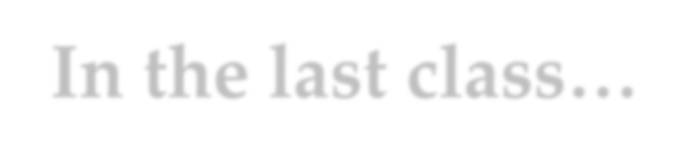
In the last class…
Single-source Shortest Path
All-pair shortest Path and Transitive Closure
Floyd-Warshall’s Algorithm for Transitive Closure
All-Pair Shortest Paths
Matrix for Transitive Closure
Multiplying Bit Matrices - Kronrod’s Algorithm
7

Slide 3
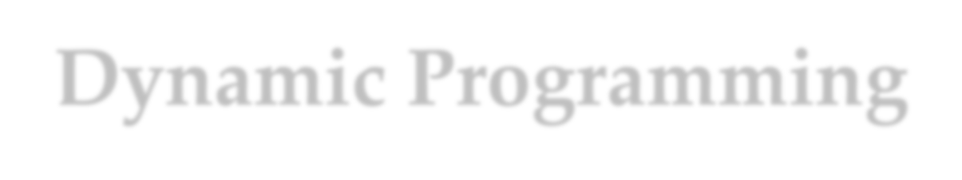
Dynamic Programming
Basic Idea of Dynamic Programming
Smart scheduling of subproblems
Minimum Cost for Matrix Multiplication
Brute-force algorithm 1, Brute-force algorithm 2
A dynamic programming solution
Weighted Binary Search Tree
The “same” dynamic programming solution
7

Slide 4
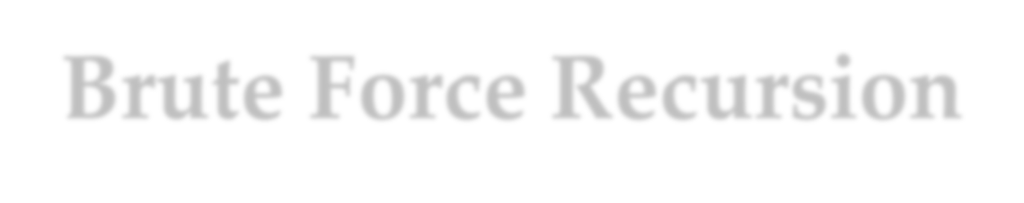
Brute Force Recursion
1
6
The F_{n} can be computed in linear time easily, but the cost for recursion may be exponential.
2
17
5
4
3
12
18
23
4
3
3
2
4
9
13
16 ₁₉
22
2 1 1
3
2
2
1
0
25
The number of activation frames are 2F_{n+1}-1
24
5
8
15
20
21
2
1
1 0 1 0
10 11
1 0
14
6
7
1
0
Fibonacci: F_{n}= F_{n-1}+F_{n-2}
For your reference
_{5 ⎞}n
_{5 ⎞}n ⎤
0, 1, 1, 2, 3, 5, 8, 13, 21, 35, ...
1 ⎡⎛1 +
⎟ − ⎜
⎠ ⎝
⎛1 −
⎟ ⎥
⎠ ⎥⎦
F_{n} =
⎢⎜
5 ⎢⎣⎝ 2
2
7

Slide 5
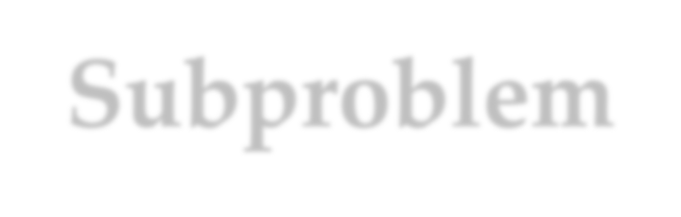

Subproblem Graph
The subproblem graph for a recursive algorithm A of some problem is defined as:
o vertex: the instance of the problem
o directed edge: I→J if and only if when A invoked on I, it makes a recursive call directly on instance J.
Portion A(P) of the subproblem graph for Fibonacci function: here is fib(6)
6 5 4 3 2 1 0
7

Slide 6
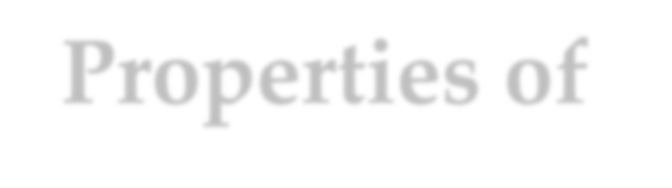
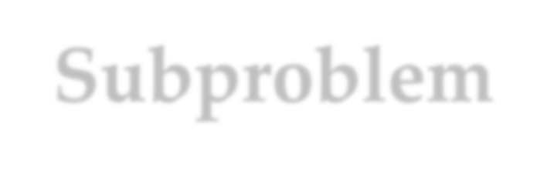

Properties of Subproblem Graph
If A always terminates, the subproblem graph for A is a DAG.
For each path in the tree of activation frames of a particular call of A, A(P), there is a corresponding path in the subproblem graph of A connecting vertex P and a base-case vertex.
The subproblem graph can be viewed as a dependency graph of subtasks to be solved.
A top-level recursive computation traverse the entire subproblem graph in some memoryless style.
7

Slide 7
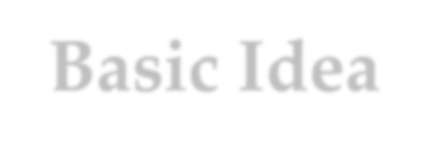

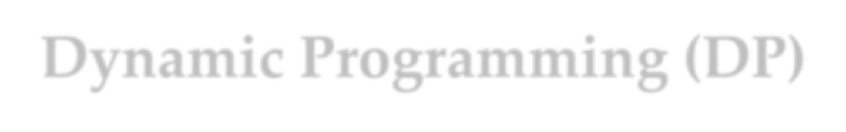
Basic Idea of Dynamic Programming (DP)
Smart recursion
Compute each subproblem only once
Basic process of a “smart” recursion
Find a reverse topological order for the subproblem graph
In most cases, the order can be determined by particular knowledge of the problem.
General method based on DFS is available
Scheduling the subproblems according to the reverse topological order
Record the subproblem solutions for later use
7

Slide 8

Recursion by DP
Case 1: White Q
Case 2: Black Q
a instance, Q, to be called on
a instance, Q, to be called on
To backtracking, record the result into the dictionary (Q, turned black)
Q
Q is finished (black), only “checking” the edge, retrieve the result from the dictionary
Q
Q is undiscovered (white), go ahead with the recursive call
Note: for DAG, no gray vertex will be met
7

Slide 9




Fibonacci by DP
fibDPwrap(n)
Dict soln=create(n); return fibDP(soln,n)
fibDP(soln,k) int fib, f1, f2; if (k<2) fib=k; else
if (member(soln, k-1)==false) f1=fibDP(soln, k-1);
else
f1= retrieve(soln, k-1);
if (member(soln, k-2)==false) f2=fibDP(soln, k-2);
else
f2= retrieve(soln, k-2); fib=f1+f2;
store(soln, k, fib);
This is the wrapper, which will contain processing existing in original recursive algorithm wrapper.
return fib
Lectures on Algorithm Design & Analysis (LAD
2015/5/26
A), 2015 9

Slide 10
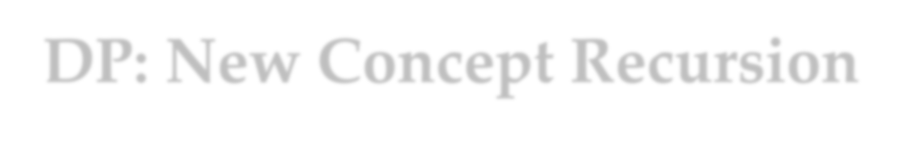




















DP: New Concept Recursion
Many subproblems
DAG of subproblems
Scheduling of subproblems
Topological ordering
Storage/retrieval of subproblem results
Subproblem dictionary
10

Slide 11
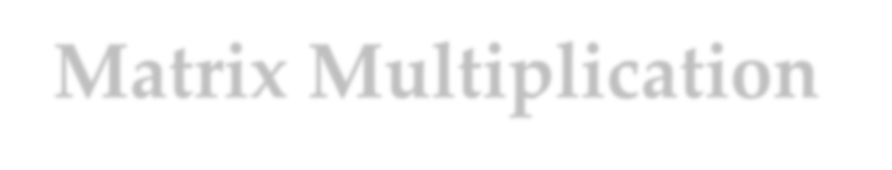
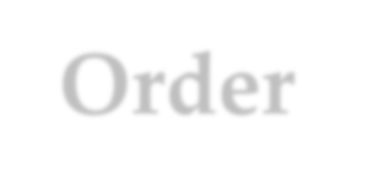
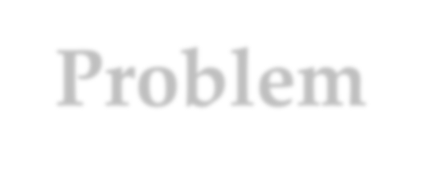
Matrix Multiplication Order Problem
The task:
Find the product: A₁×A₂×…×A_{n-1}×A_{n}
A_{i} is 2-dimentional array of different legal size
The issues:
Matrix multiplication is associative
Different computing order results in great difference in the number of operations
The problem:
Which is the best computing order
10

Slide 12

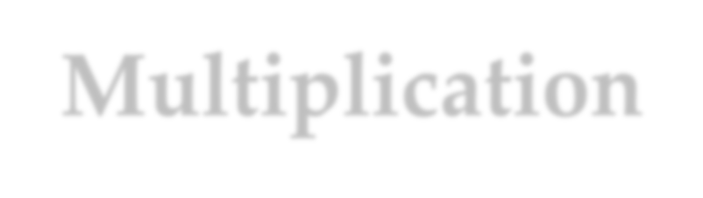

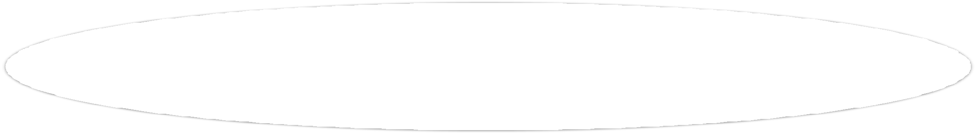
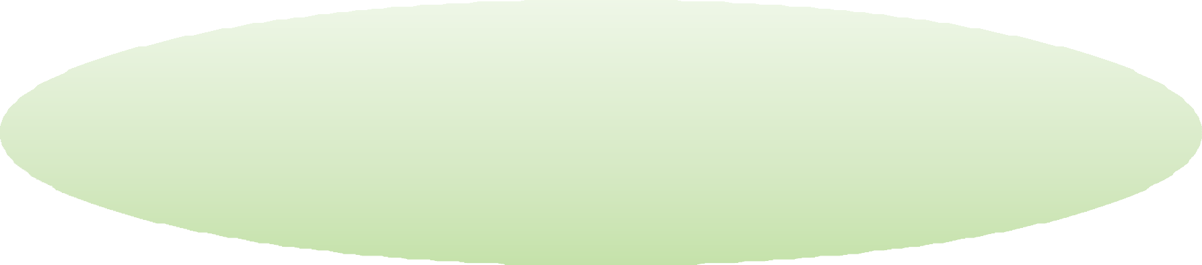
Cost for Matrix Multiplication
An example: A₁ × A₂ × A₃ × A₄ 30×1 1×40 40×10 10×25
((A₁×A₂)×A₃)×A₄: | 20700 multiplications
A₁×(A₂×(A₃×A₄)): | 11750
(A₁×A₂)×(A₃×A₄): | 41200
A₁×((A₂×A₃)×A₄): | 1400
Let C = A_{p×q}×
^{B}q⋅r
q
^{c}i, j ⁼∑ªik ^{b}kj
k =1
There are q multiplication
C has p×r elements as c_{i,j}
So, pqr multiplications altogether
10

Slide 13
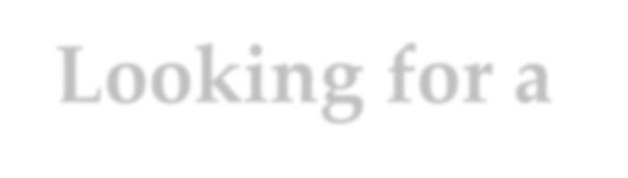

Looking for a Greedy Solution
Strategy 1: “cheapest multiplication first”
o Success: A_{30×1}×((A_{1×40}× A_{40×10})×A_{10×25}
o Fail: (A_{4×1}×A_{1×100})×A_{100×5}
Strategy 2: “largest dimension first”
o Correct for the second example above
o A_{1×10}×A_{10×10}×A_{10×2}: two results
10

Slide 14
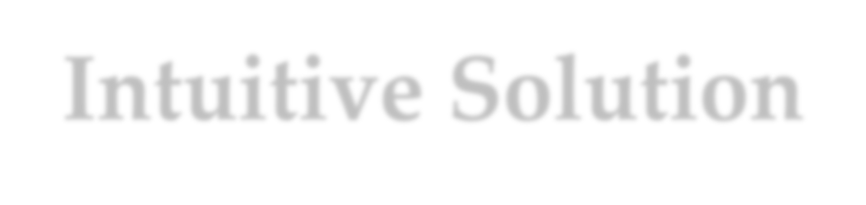
Intuitive Solution
Matrices: A₁, A₂, …, A_{n}
Dimension: dim: d₀, d₁, d₂, …, d_{n-1}, d_{n}, for A_{i} is
^{d}i-1^{×d}i
Sub-problem: seq: s₀, s₁, s₂, …, s_{k-1}, s_{len}, which means the multiplication of k matrices, with the dimensions: d_{s0}×d_{s1}, d_{s1}×d_{s2}, …, d_{s[len]-}
1^{×d}s[len] .
o Note: the original problem is: seq=(0,1,2,…,n)
10

Slide 15



Intuitive Solution
mmTry1(dim, len, seq) if (len<3) bestCost=0 else
bestCost=∞;
for (i=1; i≤len-1; i++)
Recursion on index sequence: (seq): 0, 1, 2, …, n (len=n)
with the kth matrix is A_{k} (k≠0) of the size
d_{k-1}×d_{k} ,
and the kth(k<n) multiplication is A_{k}×A_{k+1}.
c=cost of multiplication at position seq[i]; newSeq=seq with ith element deleted;
b=mmTry1(Dim, len-1, newSeq);
bestCost=min(bestCost, b+c);
return bestCost
T(n)=(n-1)T(n-1)+n,
in Θ((n-1)!)
10

Slide 16
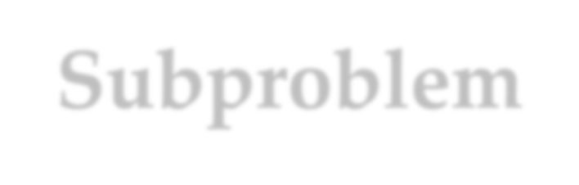

Subproblem Graph
key issue
How can a subproblem be denoted using a concise identifier?
For mmTry1, the difficulty originates from the varied intervals in each newSeq.
If we look at the last (contrast to the first) multiplication, the two (not one) resulted subproblems are both contiguous subsequences, which can be uniquely determined by the pair:
<head-index, tail-index>
10

Slide 17
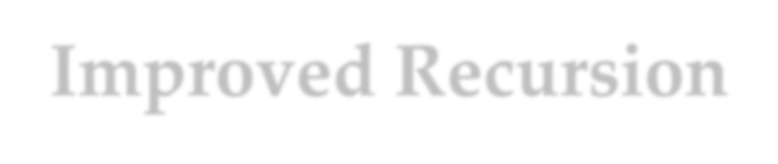






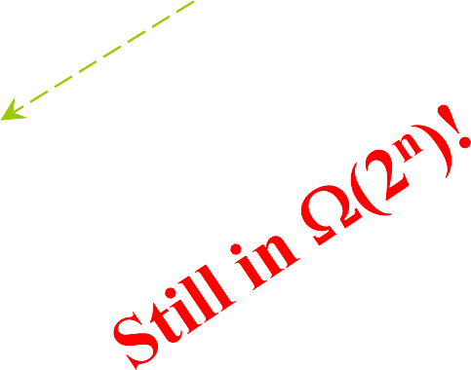
Improved Recursion
mmTry2(dim, low, high)
Only one matrix
if (high-low= =1) bestCost=0 else
bestCost=∞;
for (k=low+1; k≤high-1; k++) a=mmTry2(dim, low, k); b=mmTry2(dim, k, high);
with dimensions: dim[low], dim[k], and dim[high]
c=cost of multiplication at position k; bestCost=min(bestCost, a+b+c);
return bestCost
10

Slide 18




Smart Recursion by DP
DFS can traverse the subproblem graph in time O(n³)
At most n²/2 vertices, as <i,j>, 0≤i<j≤n.
At most 2n edges leaving a vertex
mmTry2DP(dim, low, high, cost)
……
for (k=low+1; k≤high-1; k++)
if (member(low,k)==false) a=mmTry2(dim, low, k); else a=retrieve(cost, low, k);
if (member(k,high)==false) b=mmTry2(dim, k, high); else b=retrieve(cost, k, high);
……
store(cost, low, high, bestCost);
return bestCost
Corresponding to the recursive procedure of DFS
10

Slide 19
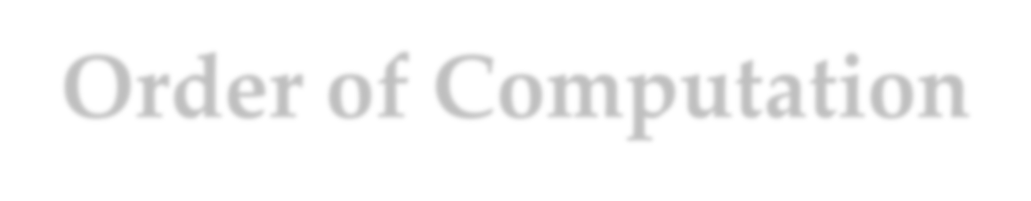







Order of Computation
Dependency between subproblems
matrixOrder(n, cost, last)
for (low=n-1; low≥1; low--)
for (high=low+1; high≤n; high++)
DP dict
Compute solution of subproblem (low,
high) and store it in cost[low][high] and last[low][high]
return cost[0][n]
10

Slide 20
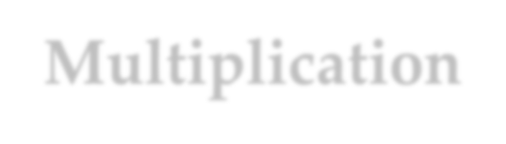
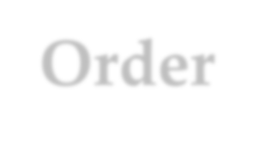



Multiplication
Order
float matrixOrder(int[] dim, int n, int[]
multOrder)
<initialization of last,cost,bestcost,bestlast…> for (low=n-1; low≥1; low--)
for (high=low+1; high≤n; high++) if (high-low==1) <base case> else bestcost=∞;
for (k=low+1; k≤high-1; k++) a=cost[low][k]; b=cost[k][high] c=multCost(dim[low], dim[k],
dim[high]);
if (a+b+c<bestCost) bestCost=a+b+c; bestLast=k;
cost[low][high]=bestCost; last[low][high]=bestLast; extrctOrderWrap(n, last, multOrder)
return cost[0][n]
20
Input: array dim =(d₀, d₁, …, d_{n}), the dimension of the matrices.
Output: array multOrder, of which the ith entry is the index of the ith multiplication in an optimum sequence.
Using the stored results

Slide 21
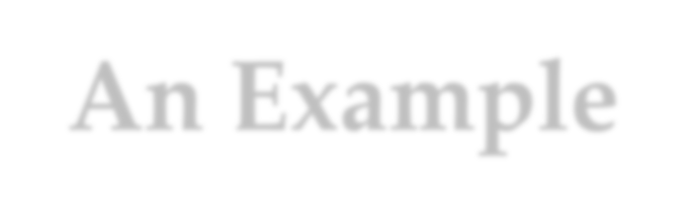






An Example
Input: d₀=30, d₁=1, d₂=40, d₃=10, d₄=25
cost as finished
Note: cost[i][j] is the least cost of A_{i+1}×A_{i+2}×…A_{j}.
For each selected k, retrieving:
⎡− 0 1200 700 1400 ⎤
⎢ − 0 400 ⎥
⎢− − − 0 10000⎥
⎢− − − − 0 ⎥
⎢
⎢⎣− − − − −
⎢₋
650 ⎥
least cost of A ×…×A .
i+1 k
least cost of A_{k+1}×…×A_{j}. and computing:
cost of the last multiplication
⎥
⎦⎥
First entry filled Last entry filled

Slide 22

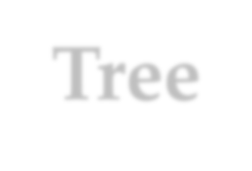




Arithmetic Expression Tree
Example input: d₀=30, d₁=1, d₂=40, d₃=10, d₄=25
last as finished
(0,4)
×
(1,4)
⎡− 1 ⎤
− 1 | 1 | 1
− | − 1 | 2
− | − | − 1
− | − | −
− | − | −
×
A
⎢₋ ₃ ⎥
1
(1,3)
×
(0,1)
(3,4)
⎢
⎢−
⎥
3 ⎥
A
4
⎢₋
₋ ⎥
1⎥
− ⎦⎥
Computing in post order
⎢
⎢⎣−
A
A
3
(2,3)
2
(1,2)

Slide 23

Getting the Optimal Order
The core procedure is extractOrder, which fills the multiOrder array for subproblem (low,high), using informations in last array.
extractOrder(low, high, last, multOrder)
int k;
if (high-low>1) k=last[low][high];
extractOrder(low, k, last, multOrder); extractOrder(k, high, last, multOrder); multOrder[multOrderNext]=k; multOrderNext++;
Just a post-order traversal
initialized in the wrapper

Slide 24


Calling Map
Output, passed to
extractOrder
float matrixOrder (int [ ] dim, int n, int [ ] multOrder )
int [ ] last; float [ ] cost; int low, high, ......
for (low=n-1; low≥1; low--)
for (high=low+1; high≤n; high++)
......
for (k=low+1; k≤high-1; k++)
<Computing all possible multCost by calling multCost>
<Filling the entries in cost and last (one entry for each)> extractOrderWrap(n, last, multOrder)
return cost[0][n];
extractOrder(low, high, last, multOrder)
<Whenever high>low, call recursively on (low,k) and (k,high) where k=last[low][high]>

Slide 25
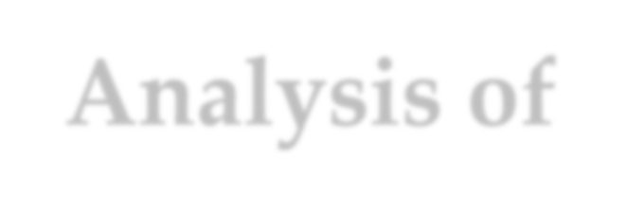
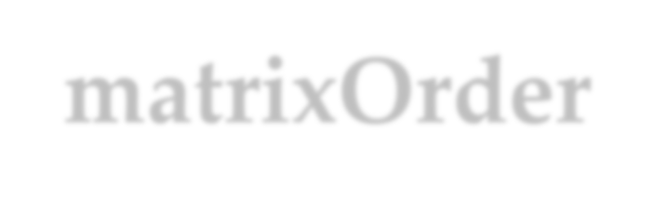
Analysis of matrixOrder
Main body: 3 layer of loops
Time: the innermost processing costs constant, which is executed Θ(n³) times.
Space: extra space for cost and last, both in Θ(n²)
Order extracting
There are 2n-1 nodes in the arithmetic-expression tree. For each node, extractOrder is called once. Since non- recursive cost for extractOrder is constant, so, the complexity of extractOrder is in Θ(n)

Slide 26
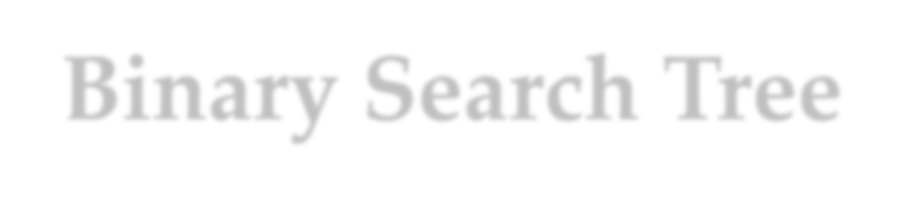









Binary Search Tree
Good balancing ₄₀
Θ(logn)
20
Poor balancing
30
Θ(n)
80
60
20
30
50
80
60
In a properly drawn tree, pushing forward to get the ordered list.
40
50
Each node has a key, belonging to a linear ordered set
An inorder traversal produces a sorted list of the keys

Slide 27


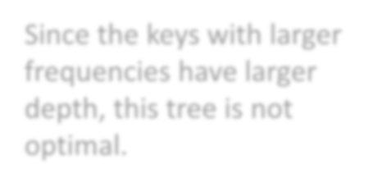




Keys with Different Frequencies
Since the keys with larger frequencies have larger depth, this tree is not optimal.
A binary search tree perfectly balanced
ring
(0.075)
n
A(T ) = ∑ p_{i}c_{i}
i=1
has
(0.025)
thing
(0.075)
Average: 3.25
cabbage
(0.025)
of
(0.125)
talk
(0.050)
walrus
(0.025)
and
(0.150)
come
(0.050)
king
(0.050)
pig
(0.025)
said
(0.075)
the
(0.150)
time
(0.050)
wing
(0.050)

Slide 28



Unbalanced but Improved
the
(0.150)
of
(0.125)
time
(0.050)
and
(0.150)
said
(0.075)
thing
(0.075)
walrus
(0.025)
come
(0.050)
ring talk
(0.075) (0.050)
wing
(0.050)
cabbage
(0.025)
king
(0.050)
pig
(0.025)
n
A( T ) =∑p_{i}c_{i} = 2.915
i=1
has
(0.025)

Slide 29




Optimal Binary Tree
The problem is decomposes by the choices of the root.
Minimizing over all choices
For each selected root K_{k} , the left and right subtrees are optimized.
K_{k}
The subproblems can be identified similarly as for matrix multOrder
K₁,…K_{k -1} K_{k +1},…K_{n}
Subproblems as left and right subtrees

Slide 30
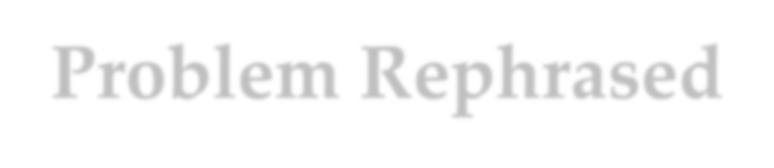
Problem Rephrased
Subproblem identification
The keys are in sorted order.
Each subproblem can be identified as a pair of index (low, high)
Expected solution of the subproblem
For each key K_{i}, a weight p_{i} is associated.
Note: p_{i} is the probability that the key is searched for.
The subproblem (low, high) is to find the binary search tree with minimum weighted retrieval cost.

Slide 31

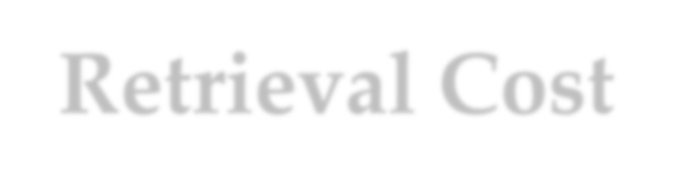
Minimum Weighted Retrieval Cost
A(low, high, r) is the minimum weighted retrieval cost for subproblem (low, high) when K_{r} is chosen as the root of its binary search tree.
A(low, high) is the minimum weighted retrieval cost for subproblem (low, high) over all choices of the root key.
p(low, high), equal to p_{low}+p_{low+1}+…+p_{high}, is the weight of the subproblem (low, high).
Note: p(low, high) is the probability that the key searched for is in this interval.

Slide 32
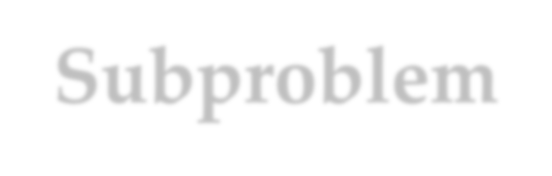
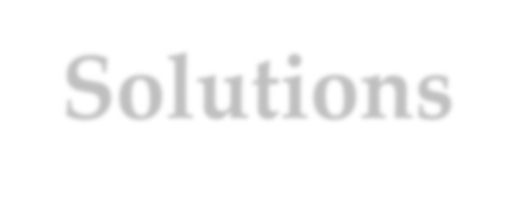
Subproblem Solutions
Weighted retrieval cost of a subtree
T contains K_{low}, …, K_{high} , and the weighted retrieval cost of T is W, with T being a whole tree.
As a subtree with the root at level 1, the weighted retrieval cost of T will be: W+p(low, high)
So, the recursive relations:
A(low, high, r )
= p_{r}+p(low, r-1)+A(low, r-1)+p(r+1, high)+A(r+1, high)
= p(low, high)+A(low, r-1)+A(r+1, high)
A(low, high) = min{A(low, high, r) | low≤r≤high}

Slide 33

Using DP
DP dictionary
Array cost
Cost[low][high] gives the minimum weighted search cost of subproblem (low,high).
The cost[low][high] depends upon subproblems with higher first index (row number) and lower second index (column number)
Array root
o root[low][high] gives the best choice of root for subproblem (low,high)

Slide 34
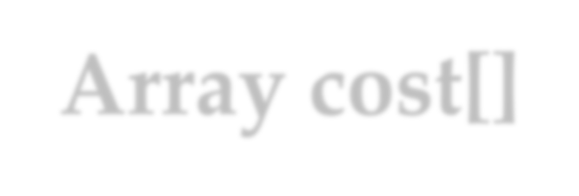



Array cost[]
high
cost[low][high]
1 0
2
p₁
0
p₂
low
p₃
0
0
0
0
p_{n}
n+1
0
0
......
n
1
2

Slide 35

Optimal BST by DP
bestChoice(prob, cost, root, low, high)
if (high<low) bestCost=0; bestRoot=-1;
else
optimalBST(prob,n,cost,root)
for (low=n+1; low≥1; low--)
for (high=low-1; high≤n; high++)
bestChoice(prob,cost,root,low,high)
return cost
bestCost=∞;
for (r=low; r≤high; r++) rCost=p(low,high)+cost[low][r-1]+cost[r+1][high]; if (rCost<bestCost)
bestCost=rCost; bestRoot=r;
cost[low][high]=bestCost; root[low][high]=bestRoot;
return
in Θ(n³)

Slide 36


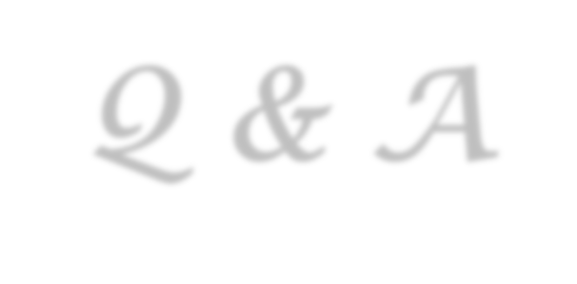

Thank you!
Q & A
Yu Huang
http://cs.nju.edu.cn/yuhuang

